Slide 1
git
Session 02 - Usages of git

Slide 2
From: To:
pull
stage zone
commit
push
Online/Local repo
Version control
.gitignore
branch
checkout
fetch
delete -d -D
fork
pull request
merge
conflict
“Git patterns”
“DevOPS”

Slide 3
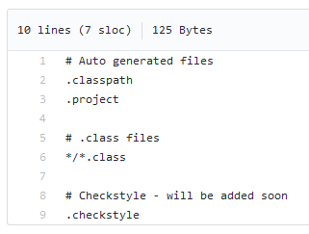
.gitignore
TODO:
/tecnoUAB_demo
Let’s create a .gitignore:
Every .png file
.sql files inside /sql_scripts (*)
/img/ folder

Slide 4
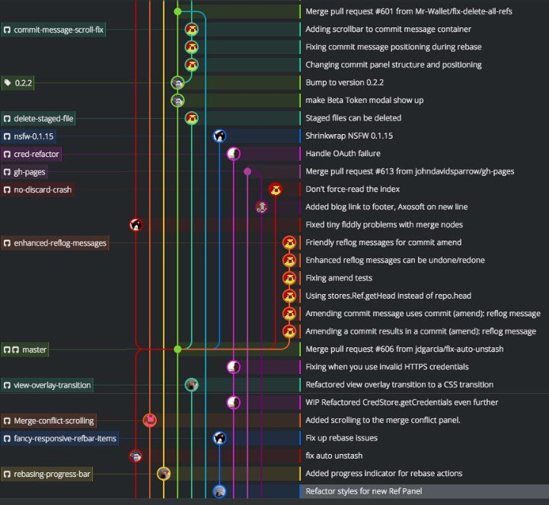
branch
TODO:
Create new branch called USERNAME_feature
Add a new feature there on your new branch

Slide 5
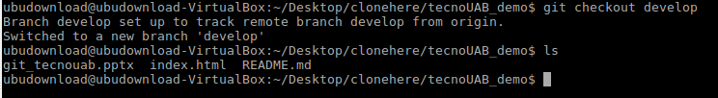
checkout
git checkout -b branch
Creates a new branch (-b) and moves there
git checkout branch
Goes to branch
We should use “git checkout” when observing a current branch or to create one.

Slide 6
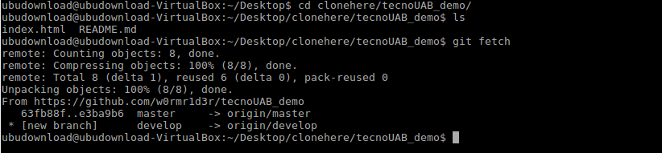
fetch
To update use -> git fetch

Slide 7

delete -d -D
-d == --delete
Deletes fully merged branch
-D
Deletes a branch, even if not merged

Slide 8

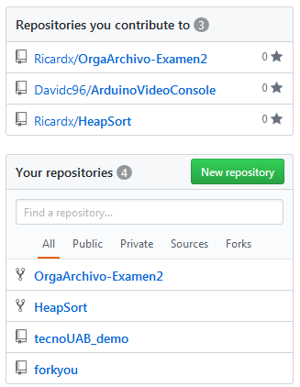
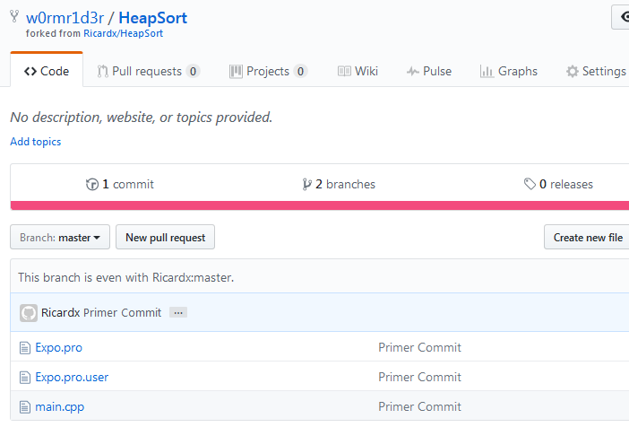
fork
To copy without affecting the original

Slide 9
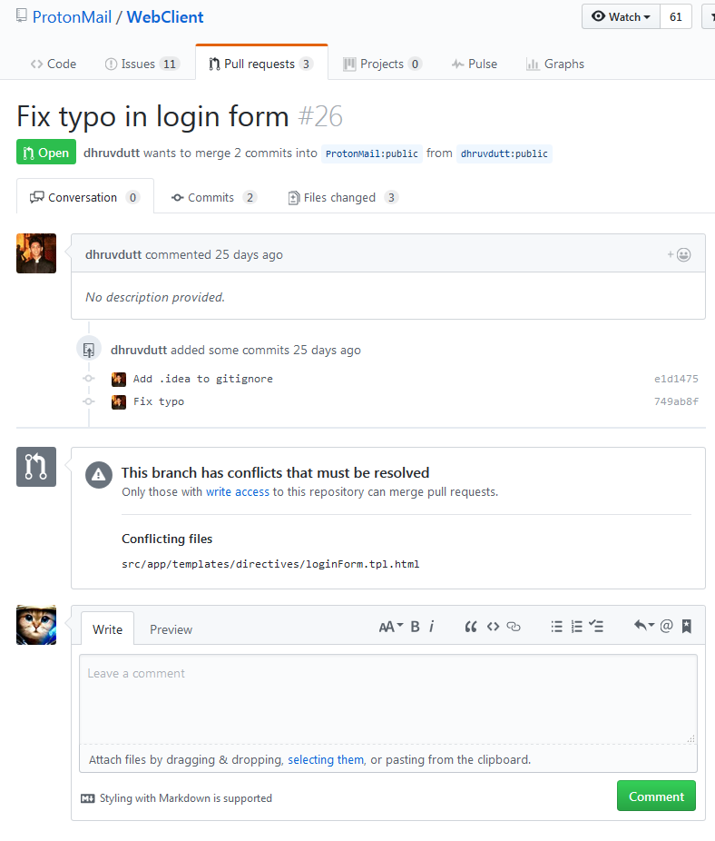
pull request
To fix someone’s repo.
Pull request =
fork + edit + pull to original

Slide 10
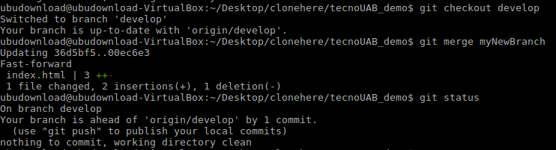
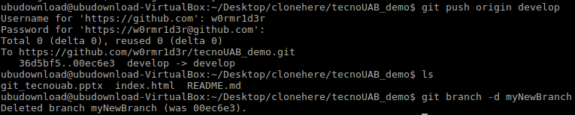
merge

Slide 11
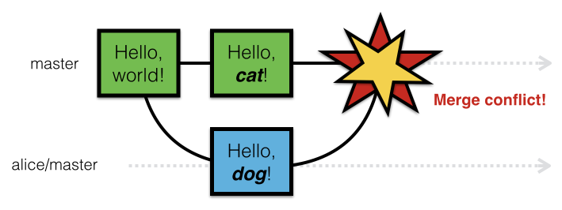
conflict

Slide 12
“Git patterns”
1 - Double master branch
2 - Branch features
3 - Master - develop - features - testing

Slide 13
“DevOPS”
www.sonarqube.org/
jenkins.io/

Slide 14
References && Extras

Slide 15
References
gitscm.com
git-scm.com/docs/
ucarecdn.com/cfcabc14-b5d1-4030-9159-442124e8cf39/
man git
www.imdb.com/title/tt0103064/
help.github.com/articles/fork-a-repo/
developer.atlassian.com/blog/2015/01/a-better-pull-request/
apawlik.github.io/2014-12-06-wise-krakow/novice/git/03-conflict.html
confluence.atlassian.com/bitbucket/resolve-merge-conflicts-704414003.html

Slide 16
Extras
Showing a very useful tool to my colleagues
thecodinglove.com/post/143006361895/showing-a-very-useful-tool-to-my-colleagues

